Slide 1
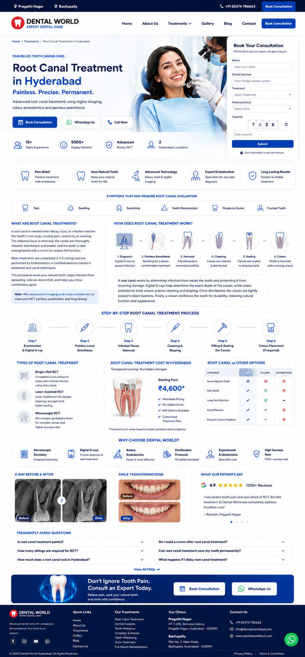
Add the text which is SEO optimized as per the google doc page https://docs.google.com/document/d/1AzGHe3m0SEdTUu6iFLb5RMb5jcQ1Qmi_FzV-DkwKZg0/edit?tab=t.0

Slide 2
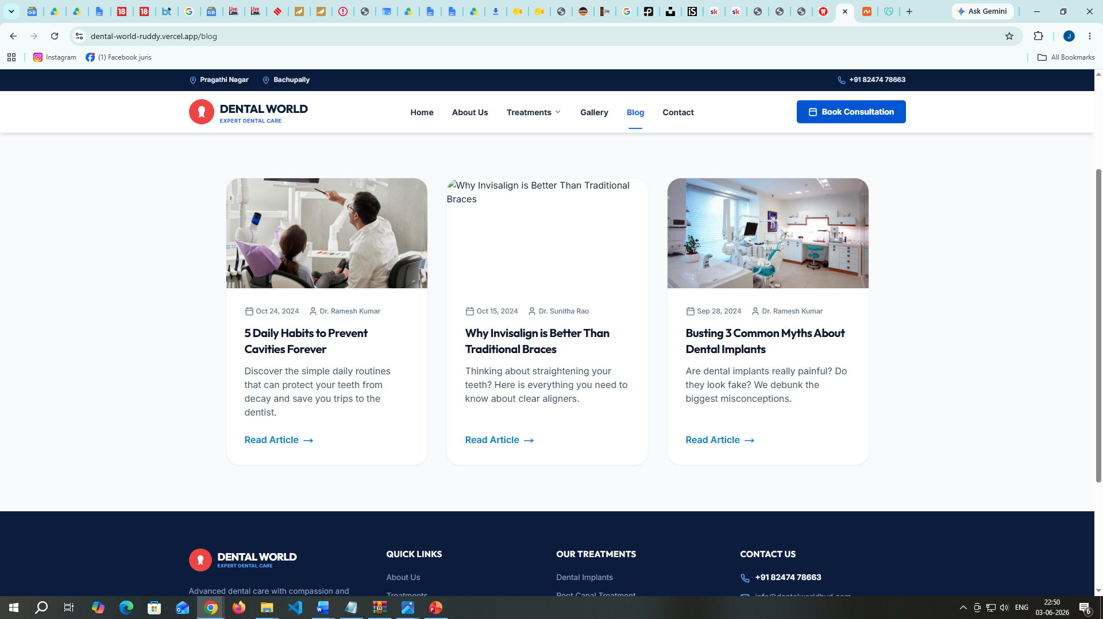
Blog
We should be able to add new blog articles
Name of the person, Image, entire text should be editable
<< 1 2 3 >>
Prev Next
Add X (twitter link beside other social media links at the footer in all pages)
Address: 2nd floor, Sri Vijaya, Lakshmi Nilayam, Pragathi Nagar Rd, near NAN convention centre, Kakatiya Hills, Near ALEAP Industrial Area, Hyderabad, Telangana 500090
Phone: 82474 78663
Address: SV LANDMARK, Bollaram Rd, beside Paramitha women and children hospital,Near Kausalya Colony, Bachupally Main Road, Hyderabad, Telangana 500118. Ph:9100061610

Slide 3
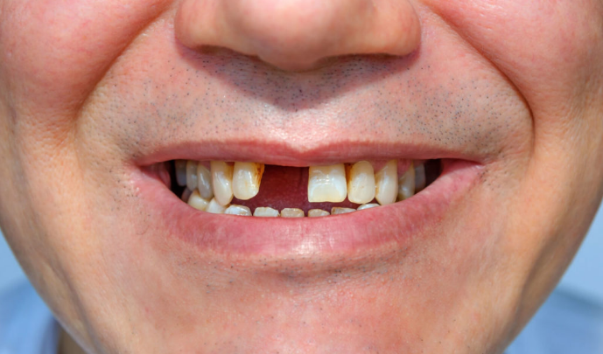
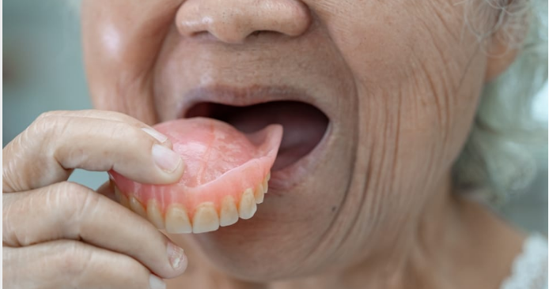
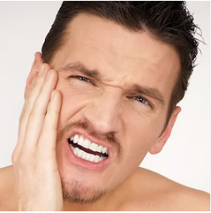

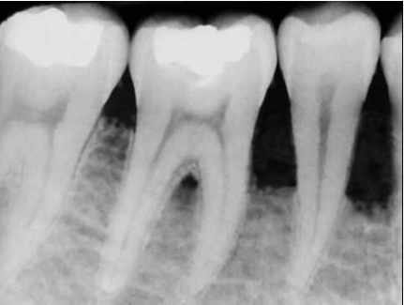
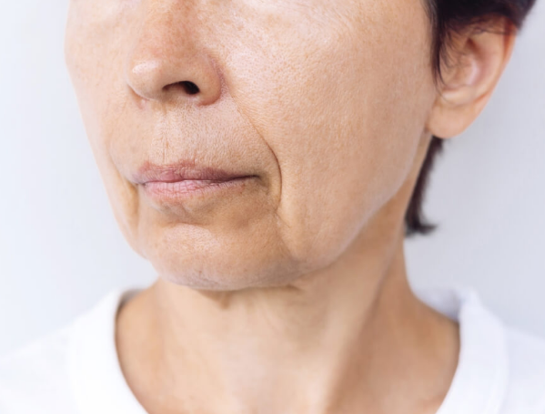
Missing teeth
Loose Denture
Difficulty chewing
Embarassing while smiling
Facial Sagging
Tooth Bone loss

Slide 4
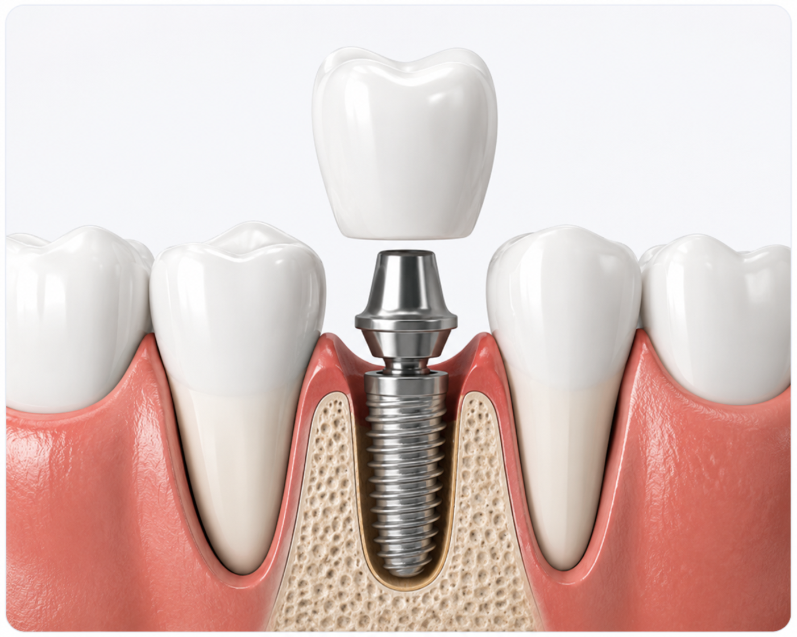
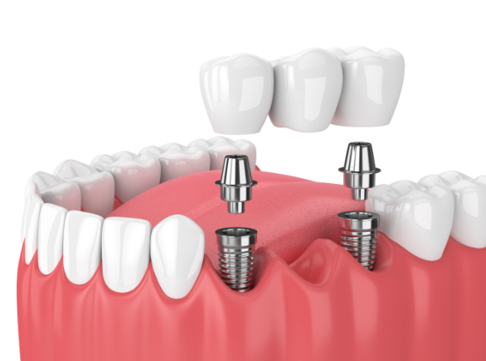
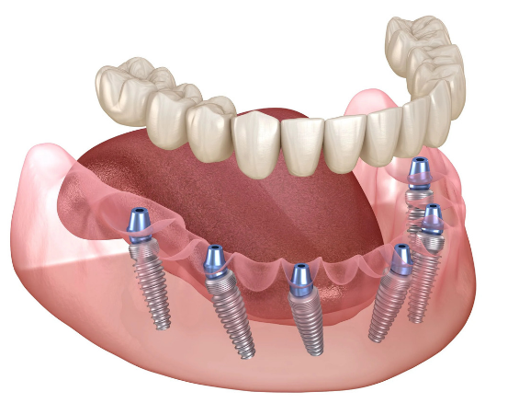
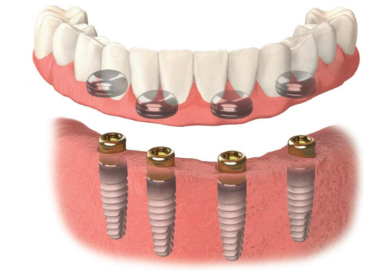
Single tooth implant
Multiple tooth implant
Full mouth implant
Implant supported Denture

Slide 5


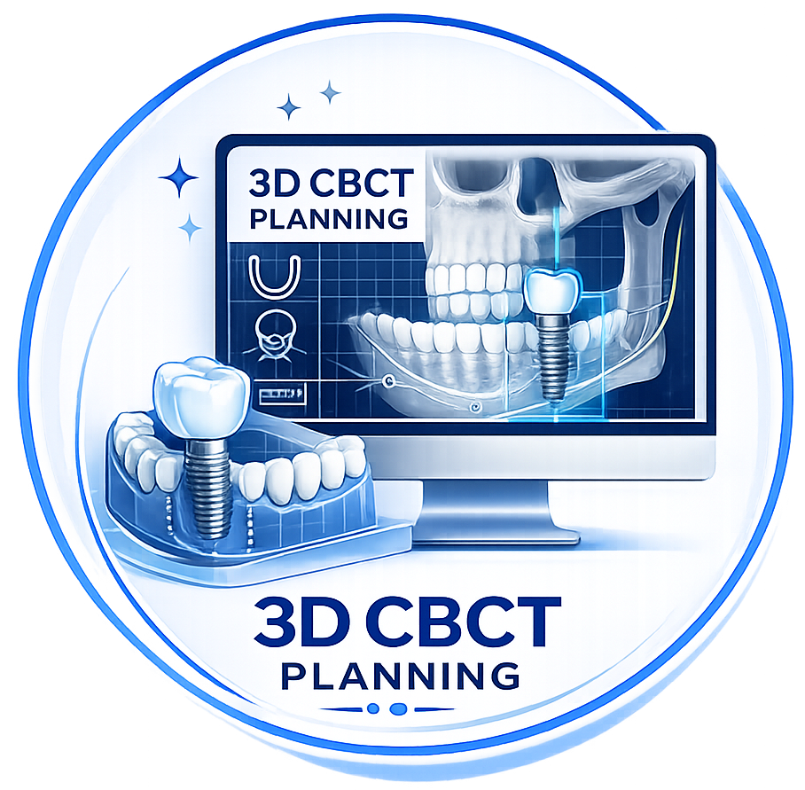


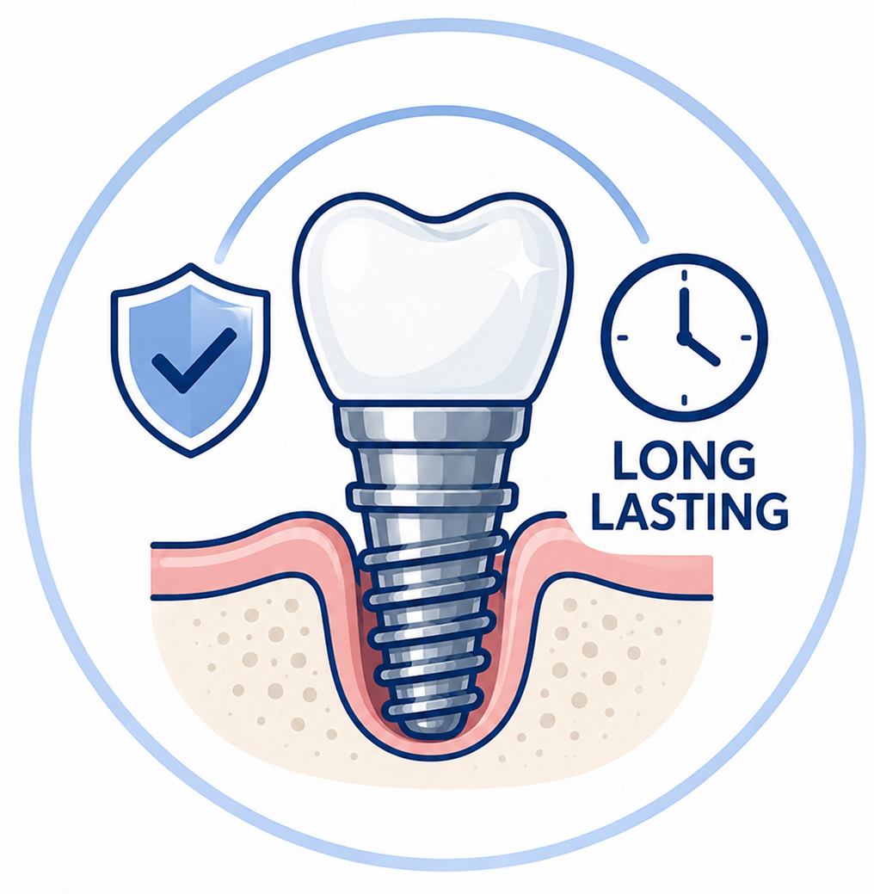
Single tooth implant
Advanced guided implant surgery
Painless Procedure
Sterile Protocol
3D CBCT Planning
Long Lasting

